Slide 1
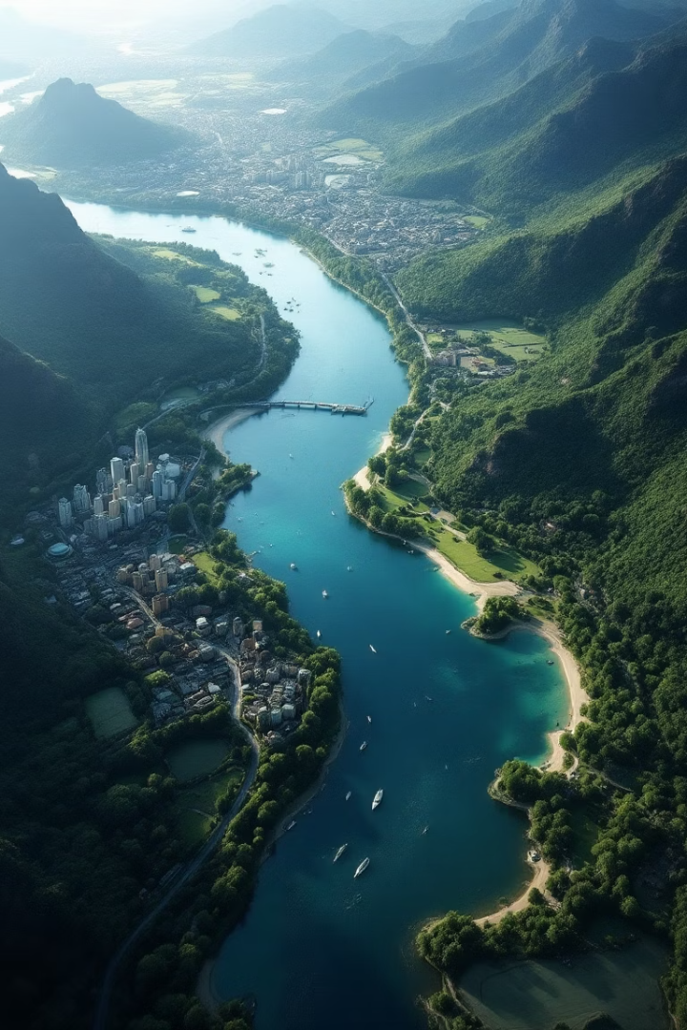
AI-Powered Land Usage Monitoring Tool
Discover the power of AI for land use classification. This tool provides insights for urban planning and environmental monitoring. It offers user-friendly predictions from satellite images, enabling informed decisions for a sustainable future.

Slide 2
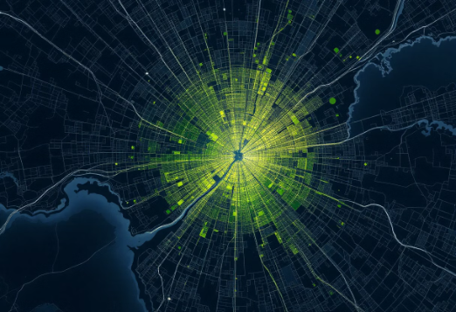
Unlocking Land Insights with Deep Learning
What is it?
Why it matters
A deep learning tool. Classifies land use from satellite images. Identifies urban areas, forests, and water bodies.
Supports urban planning
Tracks deforestation
Aids climate analysis
Key Features
U-Net model for segmentation
Flask website for predictions

Slide 3
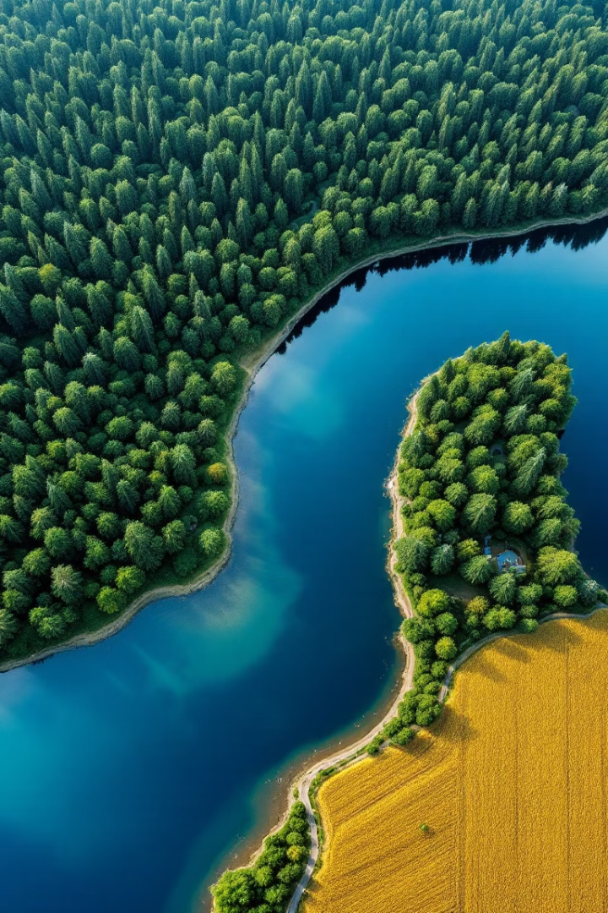
Project Objectives and Dataset
1
Build a U-Net Model
Segment 64x64 satellite images. Identify seven land use classes.
2
Create a Website
A user-friendly site for real-time predictions. Accessible to all users.
3
Achieve Reliable Classification
Maintain accuracy with limited data. Ensure consistent performance.
4
Dataset
SEN-2 LULC dataset. 149,600 training images. 32,079 validation images.

Slide 4
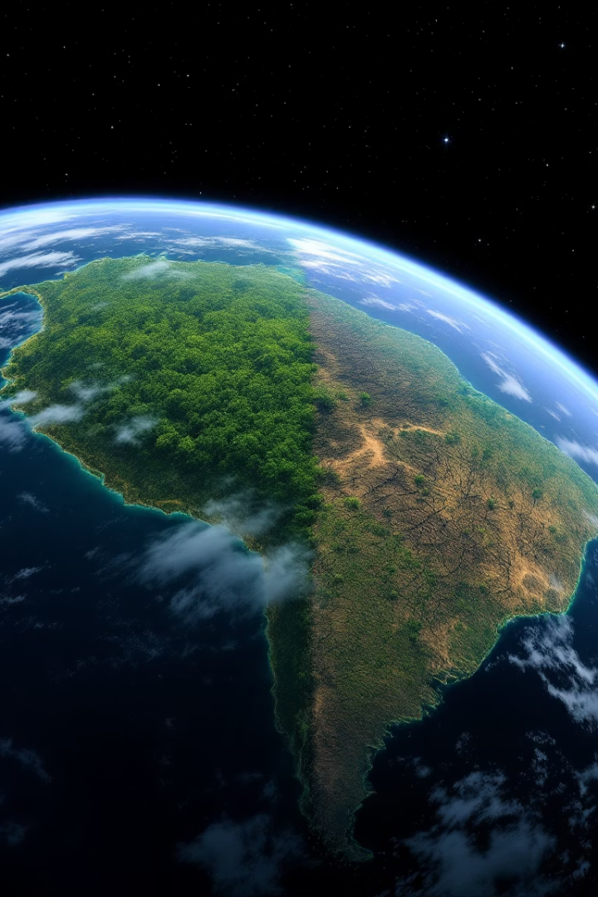
Conclusion and Project Impact
Summary
Built land use classification tool. Achieved ~60% accuracy. Deployed Flask website.
Impact
Enables environmental monitoring. User-friendly for experts and non-experts alike.
Future Steps
Increase model accuracy. Integrate more satellite data. Expand land use classes.

